Slide 1
Design patterns 2
Soon Phei, Tin

Slide 2
Behavioral Pattern
Concerned with the assignment of responsibilities between objects, or, encapsulating behavior in an object and delegating requests to it
Concerned with the way objects are interconnected. The interaction between the objects should be in such a way that they can easily talk to each other and still should be loosely coupled
The implementation and the client should be loosely coupled in order to avoid hard coding and dependencies

Slide 3
Behavioral Patterns
Chain of Responsibilities. A chain of objects is created to deal with the request so that no request goes back unfulfilled
Command. Command pattern deals with requests by hiding it inside an object as a command and send to the invoker object which then passes it to an appropriate object that can fulfill the request.
Interpreter. Interpreter pattern is used for language or expression evaluation by creating an interface that tells the context for interpretation.
Iterator. Iterator pattern is used to provide sequential access to a number elements present inside a collection object without any relevant information exchange.

Slide 4
Behavioral Patterns
State. In State pattern, the behavior of a class varies with its state and is thus represented by the context object.
Strategy. Strategy pattern deals with the change in class behavior at runtime. The objects consist of strategies and the context object judges the behavior at runtime of each strategy.
Visitor. A Visitor performs a set of operations on an element class and changes its behavior of execution. Thus, the variance in the behavior of element class is dependent on the change in visitor class.

Slide 5
Behavioral Patterns
Mediator. Mediator pattern provides easy communication through its mediator class that allows communication for several classes.
Observer. A One-to-Many relationship calls for the need of Observer pattern to check the relative dependencies of objects.

Slide 6

Chain of Responsibilities
Request route from one service to the other.
Each service is responsible for one job function.

Slide 7
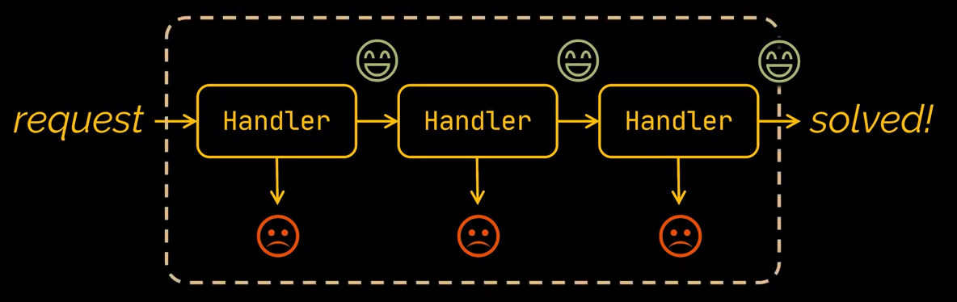
Chain of Responsibilities Pattern
used to achieve loose coupling in software design where a request from client is passed to a chain of objects to process them.
Then the object in the chain will decide themselves who will be processing the request and whether the request is required to be sent to the next object in the chain or not.

Slide 8
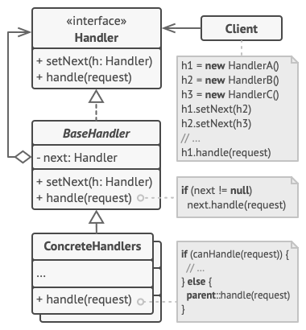
Key Components
Handler: Define the interface for the method for handling request. Sometimes also define the interface for the method to set the next handler.
BaseHandler : This is an optional abstract class. Base class of the concrete handlers. Usually define the boilerplate code common to all concrete handlers.
Concrete handlers : These are actual handlers of the request chained in some sequential order. It contain the actual processing of the requests.
Client : Originator of request and this will access the handler to handle it. It composes the chain of handlers statically or dynamically.

Slide 9
User Authentication and Authorization Example
The process to authenticate and authorize a user is as follow
Check that the user enter an existing username
Check that the user enter a corresponding password
Check the attached roles of the user
Use the Chain of Responsibility pattern to design the software.
User Login
Check Username
Check Password
Check Roles

Slide 10


Implementation
LoginService
false
UserExistHandler
ValidPasswordHandler
CheckRoleHandler
BaseHandler
BaseHandler
BaseHandler
handleNext
handleNext
handleNext
false

Slide 11
Exercise 1
Observe the code in the following slides
How the implementation in the code different from the design?
How do you amend the code to align with the design?

Slide 12
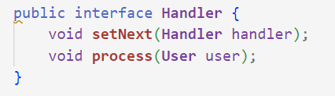
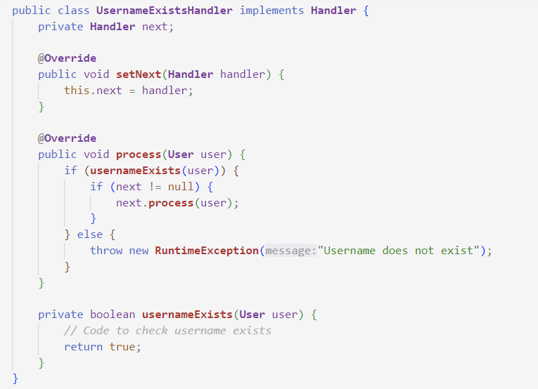

Slide 13
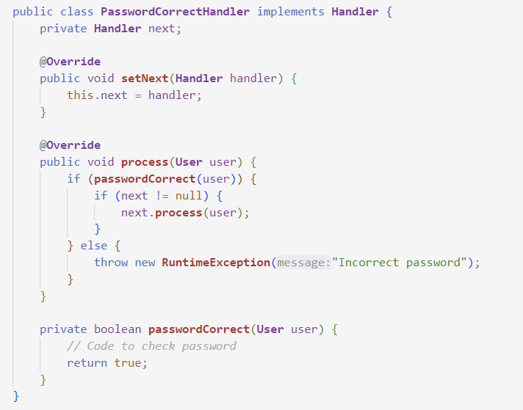
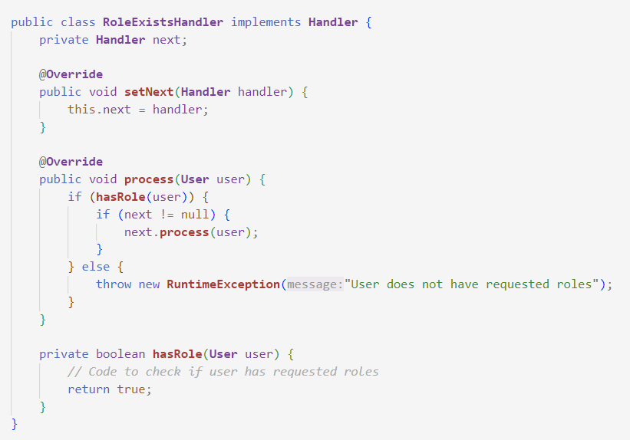

Slide 14
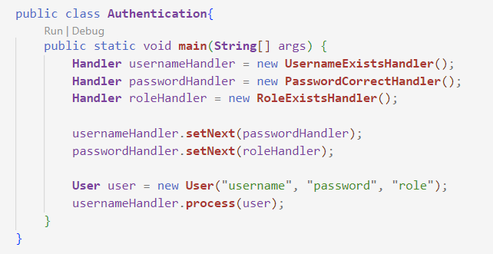

Slide 15
Important Note
Client can set the processing order and it will send the request to the first handler in the chain.
Each handler in the chain will have its own implementation to process the request. It will then send the remaining tasks to the next handler in the chain for further processing.
Every handlers in the chain should have reference to the next handler in chain to forward the request to.
Creating the chain carefully is very important otherwise there might be a case that the request will never be forwarded to a particular handler or there are no handler in the chain who are able to handle the request.
Chain of Responsibility design pattern is good to achieve loose coupling, but it comes with the trade-off of having a lot of implementation classes and maintenance problems if most of the code is common in all the implementations.

Slide 16
Benefits
Reduced Coupling: The pattern frees an object from knowing which other object handles a request.
Added Flexibility: You can add, remove, or change the order of responsibility dynamically or at runtime.
Clear Sequential Process: Chain of Responsibility pattern provides a very clear and explicit control over the sequence.
Simplicity: Avoid using complicated code with multiple conditionals to handle different types of requests, the pattern chains the receiving objects and passes the request along the chain until an object handles it.
Separation of Concerns: Each handler is independent of others and doesn't need to know about the inner workings of other handlers.

Slide 17
Application of Chain Of Responsibility
Use the Chain of Responsibility pattern when your program is expected to process different kinds of requests in various ways, but the exact types of requests and their sequences are unknown beforehand.
Use the pattern when it’s essential to execute several handlers in a particular order.
Use the CoR pattern when the set of handlers and their order are supposed to change at runtime.

Slide 18
ATM Problem
In ATM dispense machine, the user enters the amount to be dispensed and the machine dispense amount in terms of defined currency bills such as $50, $20, $10 etc.
If the user enters an amount that is not multiples of 10, it throws error.
We will use Chain of Responsibility pattern to implement this solution. The chain will process the request in the same order as below image.
Note that we can implement this solution easily in a single program itself but then the complexity will increase, and the solution will be tightly coupled.
ATM Dispenser
$50 Dispenser
$20 Dispenser
$10 Dispenser

Slide 19
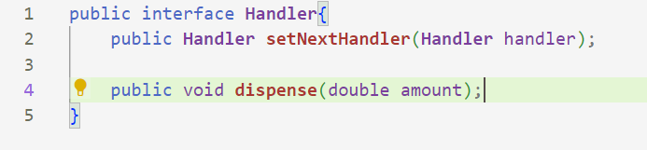
Implementation
Given the below interface, implement the ATM program using Chain of Responsibility design pattern
Implementation tips
For each handler, in the dispense method, if the amount to dispense is greater than the amount the handler need to dispense, then
Calculate the number of notes to dispense
Calculate the remaining amount and call the next handler to dispense the remaining amount
Remember to check if there is any next handler

Slide 20
Exercise 2
Consider an example of handling HTTP requests on a web server. In a web server, multiple types of operations need to be performed on a HTTP request. These can include authentication checks, logging, data validation, and finally handling the actual request. Using the Chain of Responsibility pattern, you can decouple these operations and create a chain where each operation is handled by a separate object. Show your proposed implementation.

Slide 21
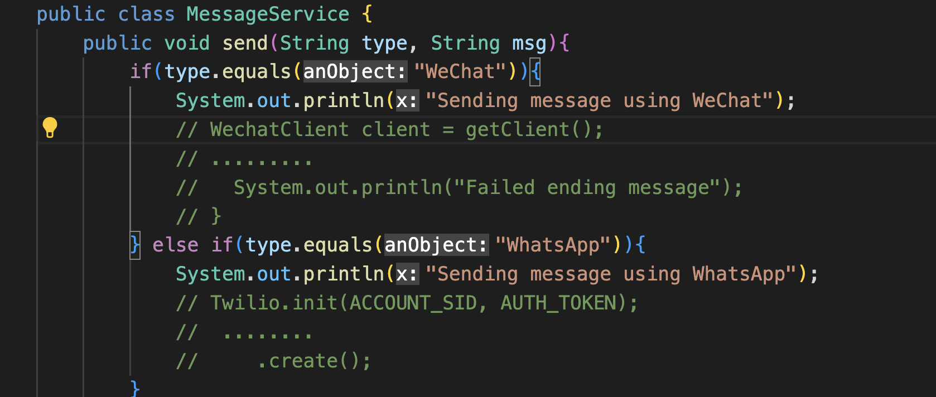
Strategy Design Pattern
A program to send messages using multiple messaging services
What are the problems with this code?

Slide 22
Strategy Design Pattern
Strategy pattern deals with the change in class behavior at runtime. The objects consist of strategies and the context object judges the behavior at runtime of each strategy
Place each messaging type into its own class to achieve single responsibility principle.
These classes can easily interchangeable without modification.

Slide 23
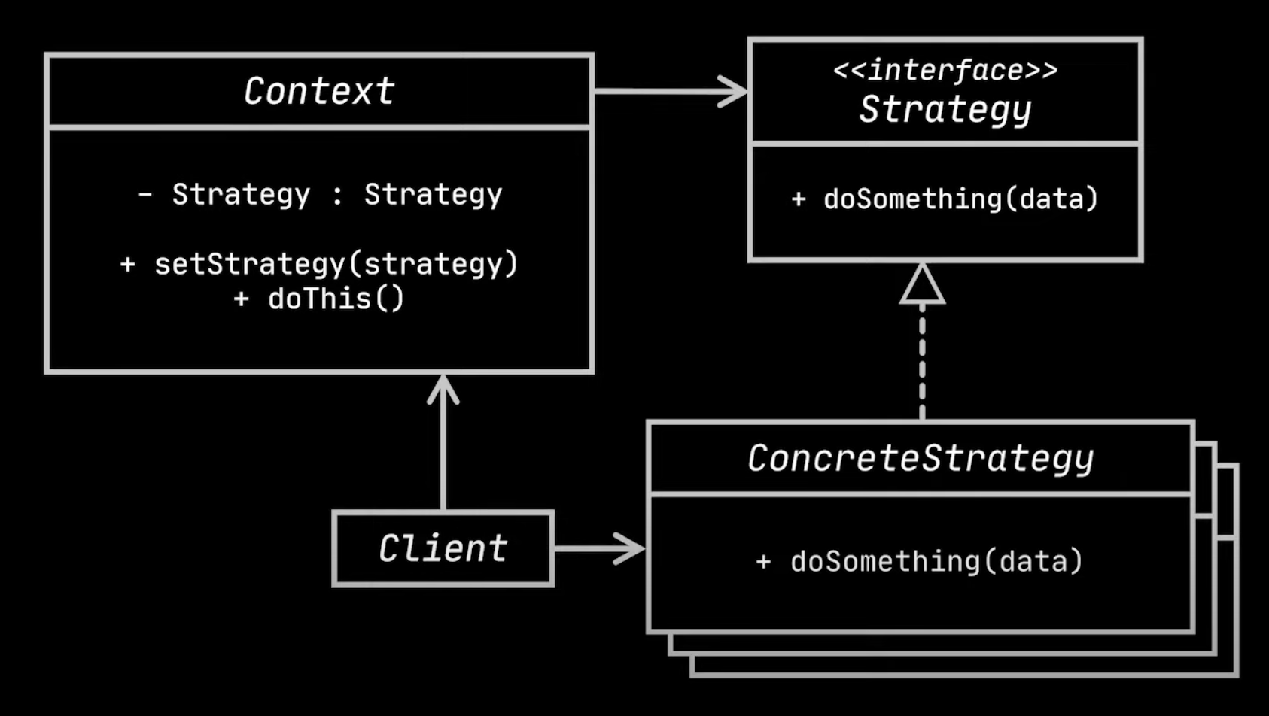
Key Components
Context: Maintains a reference to a concrete strategy and communicate with it via interface.
Strategy interface: This is an interface common to different algorithms.
Concrete strategy: Provide its own implementations for the interface.
Client: Creates a specific strategy object and passes it to the context

Slide 24
Strategy Design Pattern – Ecommerce Example
Let's take an example of a payment system in an e-commerce application:
In such an application, customers may have different preferred methods of payment; some may like to pay with credit cards, others with debit cards, PayPal, bank transfer, or even cryptocurrencies. Trying to manage all these payment methods within a single class would make your code complex and harder to maintain.
With the Strategy pattern, you can define a common interface for all payment methods, with each payment method implemented as a separate class (Concrete Strategy). The Context class (in this case, the shopping cart or payment processing class) can then use this interface to delegate the payment processing task to the payment method selected by the user.

Slide 25
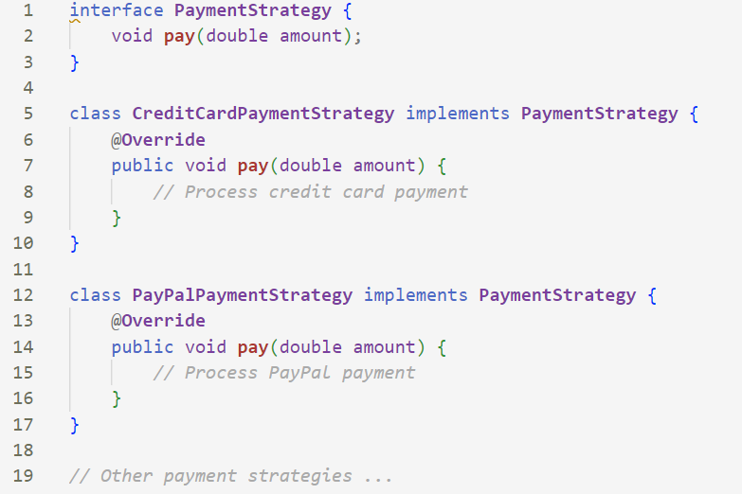
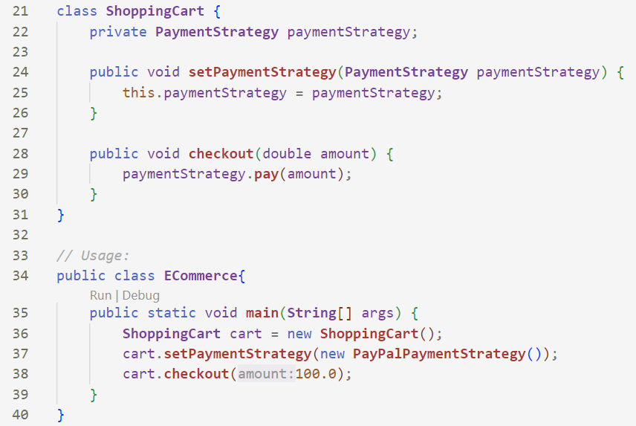
ECommerce Example

Slide 26
Benefits
Flexibility: You can alter the application's behavior at runtime by replacing the strategy object within the context object.
Encapsulation: Related algorithms are grouped into strategy classes, which encapsulate complex behavior that could otherwise clutter other classes.
Reusability: Since the strategy classes are decoupled from the context, they can be reused across different contexts.
Maintainability: The Strategy Design Pattern makes the code more maintainable. Changes to one strategy do not affect others. Adding a new strategy or updating an existing one involves changes only to the strategy class itself, not the context class.
Testing: Each strategy can be tested independently of the context and other strategies, which makes unit testing easier and more robust

Slide 27
Application of Strategy Design Pattern
The Strategy design pattern shines in scenarios where an object's behavior or algorithm can change dynamically at runtime. It's especially useful when you have several variants of an algorithm or operation and the exact variant to be used isn't known until runtime.

Slide 28
Exercise 3
Courier Service Problem
The cost calculation for courier service is base on the type of item to be sent. Currently there are 2 type of items can be sent using the courier service, namely Parcel and Document.
The algorithm to calculate the cost of sending Parcel is first calculate using algorithm A which is base on the weight, and then calculate using algorithm B which is base on the dimension. The final cost is the cost from either algorithm A or B depending on whichever is higher.
The algorithm to calculate the cost of sending Document is algorithm C.
In your problem, algorithm A, B, and C is negligible.
Write a program following Strategy Design Pattern for the problem.

Slide 29
Exercise 4
You are tasked with designing a flexible sorting system for a data analysis application. The application needs to sort lists of data in various ways, such as by numerical value, alphabetical order, or custom-defined criteria. The sorting method should be easily interchangeable during the run-time without modifying the existing code structure.
Task:
Describe the Strategy design pattern and explain how it can be applied to solve the problem of interchangeable sorting methods.
Draw a class diagram to represent your design for the system. Include at least three different sorting strategies: numerical, alphabetical, and a custom strategy of your choice.
Briefly explain the advantages of using the Strategy pattern in this context.

Slide 30
Answer
Description of Strategy Pattern:
The Strategy pattern defines a family of algorithms, encapsulates each one, and makes them interchangeable. This pattern allows the algorithm to vary independently from the clients that use it.
Advantages of Using the Strategy Pattern:
Flexibility: It allows the client to choose and change the sorting algorithm at runtime without altering the client code.
Maintainability: New sorting strategies can be added easily without modifying existing classes, adhering to the Open/Closed Principle.
Reusability: Different sorting strategies are encapsulated in their own classes, making them reusable across different context.

Slide 31
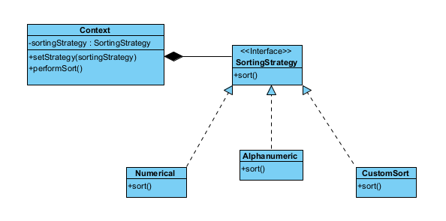
Answer

Slide 32
State Pattern
The State pattern is a behavioral pattern - it's used to manage algorithms, relationships and responsibilities between objects.
The definition of State provided in the original Gang of Four book on Design Patterns states: Allows an object to alter its behavior when its internal state changes. The object will appear to change its class.

Slide 33
State Pattern – The Structure
Context
<interface>
State
-state
+request()
+setState(state)
+handle()
ConcreteState 1
ConcreteState 2
+handle()
+handle()

Slide 34
Key Components
Context stores a reference to one of the concrete state objects and delegates to it all the state-specific work. The context communicates with the state object via the state interface. The context exposes a setter for passing it a new state object.
The State interface defines a common interface for all concrete states, encapsulating all behavior associated with a particular state.
Concrete States provide their own implementations for the state-specific methods. To avoid duplication of similar code across multiple states, you may provide intermediate abstract classes that encapsulate some common behavior.
Both context and concrete states can set the next state of the context and perform the actual state transition by replacing the state object linked to the context.

Slide 35
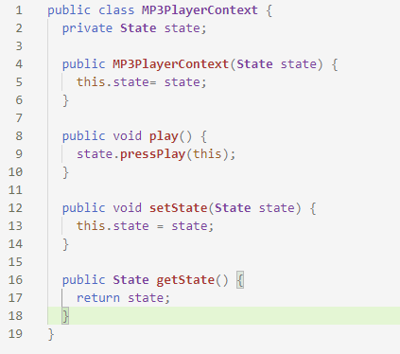
MP3 Example

Slide 36

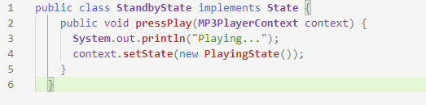
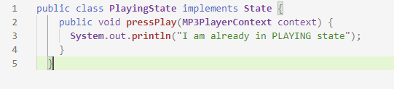

Slide 37
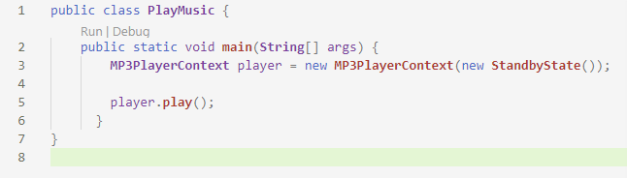

Slide 38
Workflow System
One complex scenario where State Design Pattern can be beneficial is a workflow system. A workflow includes a number of processes that usually occurs in a sequence, where each process has its own set of rules, responsibilities, and the transition to the next process.
For instance, let's consider a Document Approval System where a document goes through several states:
Draft, Review, Approve, Disapprove

Slide 39
Exercise 5
Draw a class diagram for the following workflow program.

Slide 40
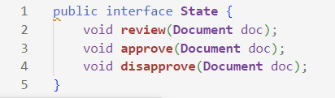
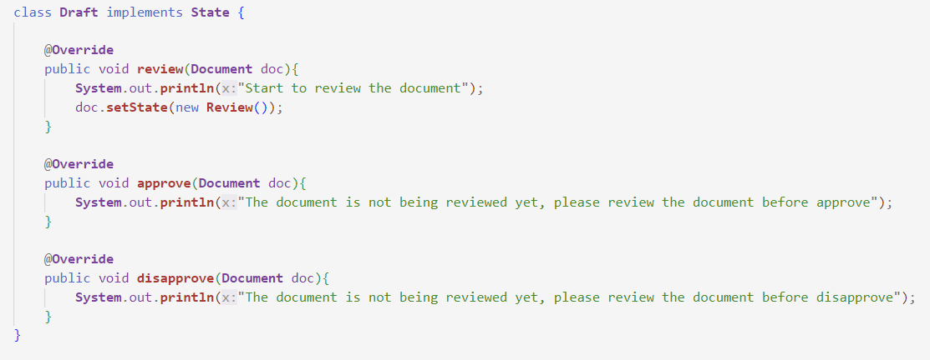

Slide 41
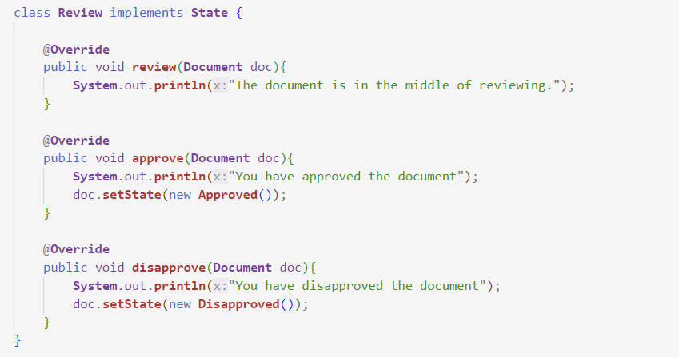
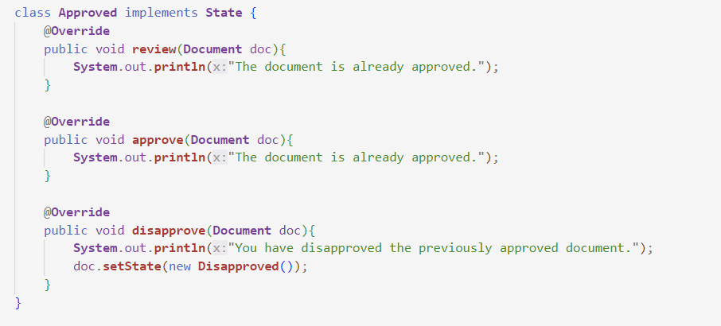
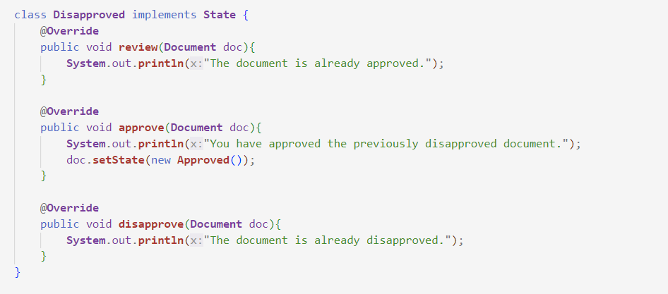

Slide 42
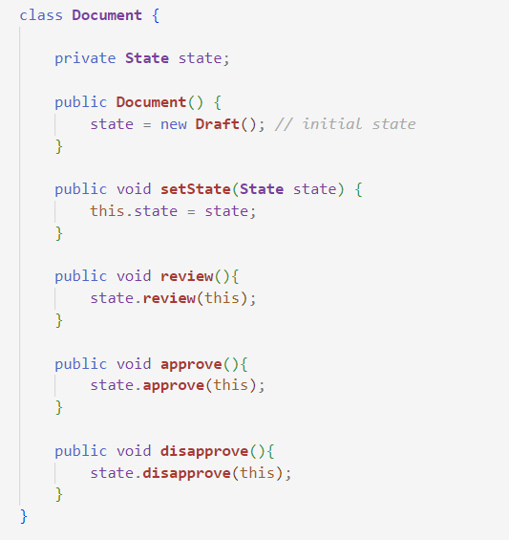
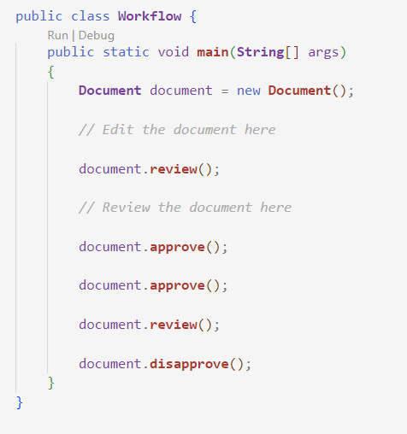

Slide 43
Benefits
Organized Control Flow: The State pattern can improve control flow if a system often switches between a number of states in a complex manner.
Localize State-Specific Behavior: All state-related operation is coded into separate classes. This approach allows you to group the states' behaviors within corresponding state class itself.
State Transitions Explicit: State transitions can be made more explicit and predictable. The code is easier to read and understand.
Extensibility: New states can be added easily by just creating new state classes.
Simplify Code: The State Pattern helps to clean up the code by eliminating large monolithic conditional blocks.

Slide 44
Application of State Pattern
Use the State pattern when you have an object that behaves differently depending on its current state, the number of states is enormous, and the state-specific code changes frequently.
Use the pattern when you have a class polluted with massive conditionals that alter how the class behaves according to the current values of the class’s fields.
Use State when you have a lot of duplicate code across similar states and transitions of a condition-based state machine.

Slide 45
Exercise 6
A traffic light commonly has three states:
Red: Vehicles must stop.
Green: Vehicles can go.
Yellow: Vehicles should prepare to stop, as it will turn red soon.
Here are the behaviors and transitions for these states:
In the Red state, after a certain period, the state transitions to Green, allowing vehicles to go.
In the Green state, after a certain period or if emergency conditions are noticed, the state transitions to Yellow as a signal to prepare for a stop.
In the Yellow state, after a brief period, the state transitions to Red, indicating the vehicles must stop.
The Traffic Light object (Context) can contain a state reference to manage its current Traffic Light State (State). The State interface or abstract class declares the method changeLight(), which changes the state of the traffic light object. The concrete state classes (Red, Green, Yellow) implement the changeLight() function to dictate how state changes.
Solve the problem using State design pattern.

